Slide 1
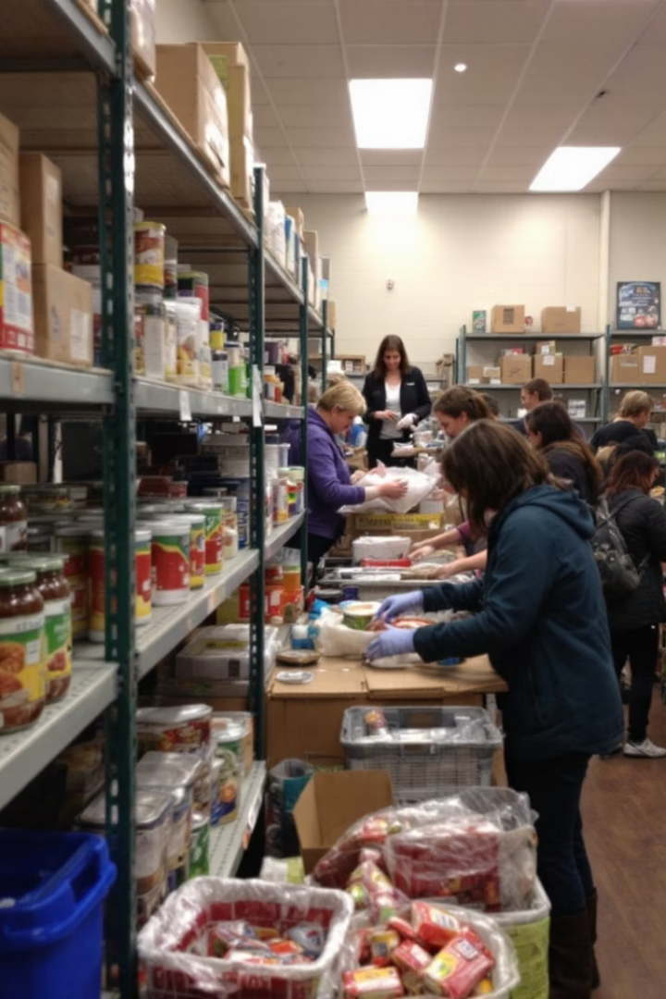
The Belly Club
This presentation outlines our comprehensive Food Bank Management System. It is designed to streamline operations, improve transparency, and ensure food security. Our system covers inventory, donor records, and recipient profiles.The core focus is on efficient data handling, secure storage, and insightful analytics to support food distribution.
Group no: 06
Ayush
Natnicha
Yagna
Rian

Slide 2

Project Overview
Streamline Food Distribution
Efficiently manage and distribute food to those in need.
Improve Transparency
Maintain clear and accessible records of all transactions.
Support Community Engagement
Foster stronger connections between the food bank, donors, and recipients.
Ensure Food Security
Use data-driven insights to help maintain stock levels and prioritize those in need.

Slide 3
Entity Relationship Diagram

Slide 4


Key System Views
VIEW_FOOD_DISTRIBUTION_SUMMARY
Combines donor, recipient, transaction, and inventory data. Displays total food distributed per recipient, date, and food type.
VIEW_WEEKLY_DONOR_ACTIVITY
Aggregates donor contributions by week, showing quantity and type of food donated. Useful for donor engagement and report generation.
Security Implementation
Encryption Setup
Protects sensitive donor and recipient data.
SQL Server
Implements encryption via master key, certificate, and
symmetric key.

Slide 5
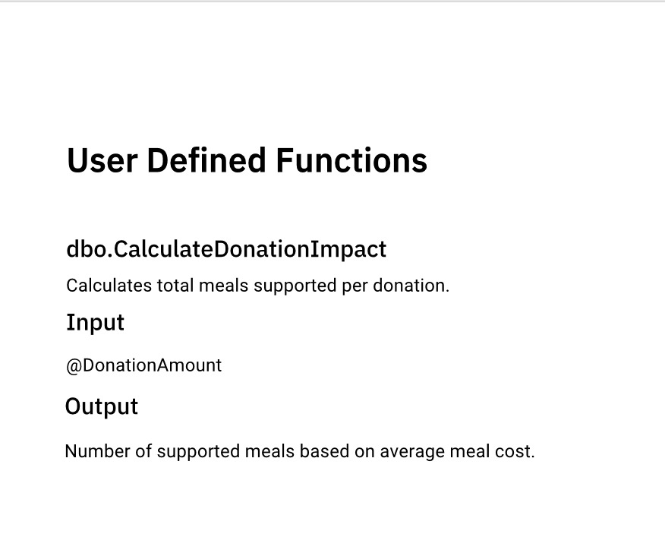
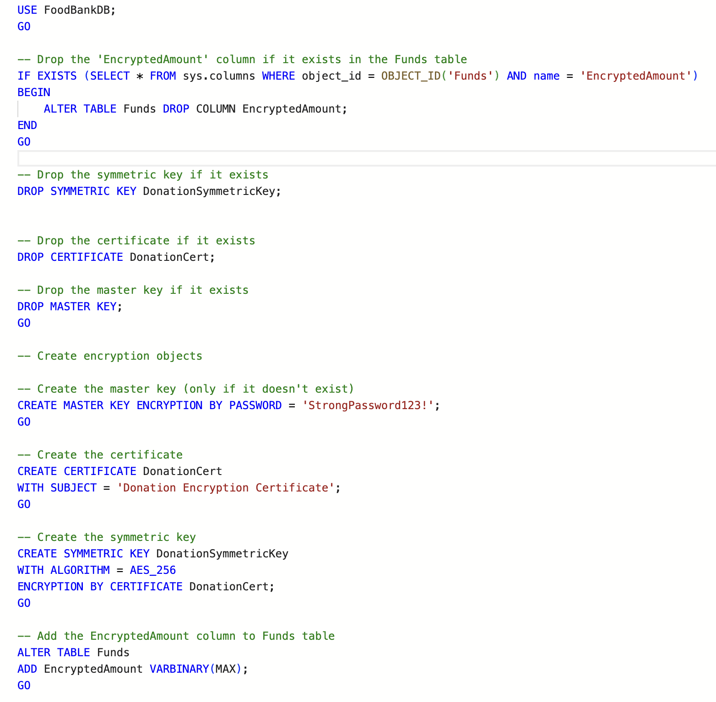
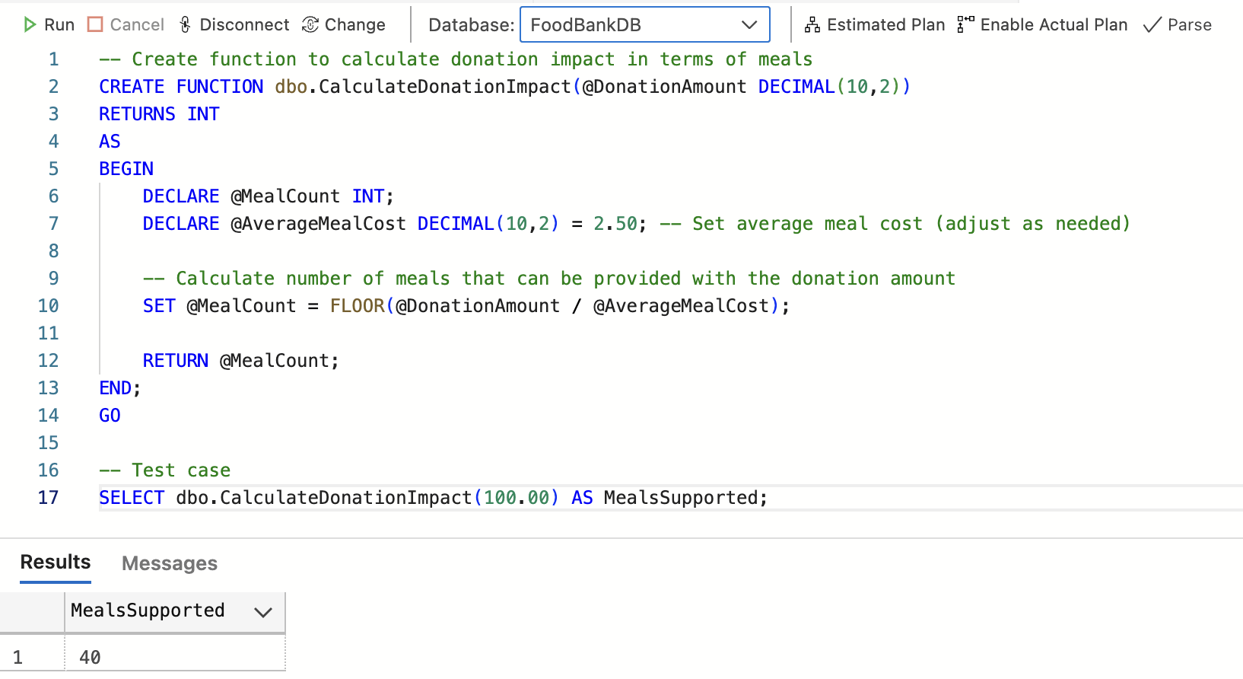
SQL Encryption Implementation for The Belly Club
This implementation establishes a robust encryption system for sensitive
financial information in our food bank database. Using SQL Server's native
cryptography features, it creates a hierarchical security structure with
master keys, certificates, and symmetric keys to protect donation amounts
while maintaining database functionality.

Slide 6
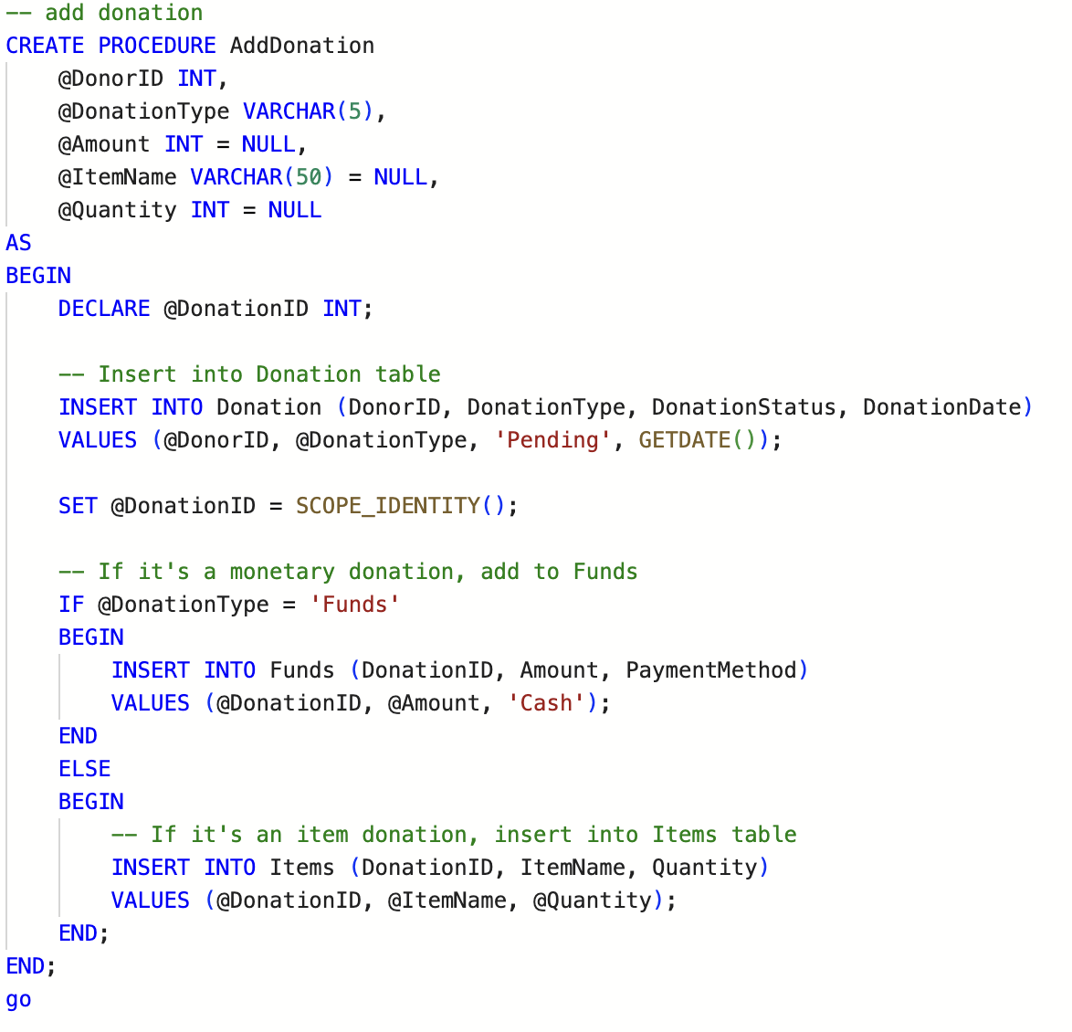
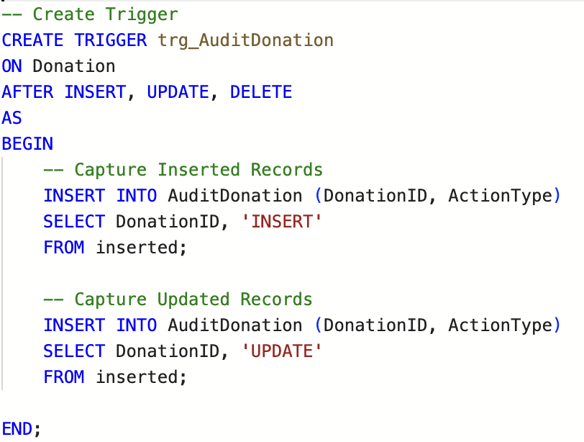
Database Triggers
Stored Procedures
Trigger: trg_AuditDonation
This trigger is defined to fire on the Donation table after
INSERT, UPDATE, and DELETE operations. It captures
information about these operations and logs them in the
AuditDonation table.
Procedure: AddDonation
This procedure handles the creation of new donations in the system.
It's designed to handle both monetary (Funds) and physical (Items)
donations.

Slide 7
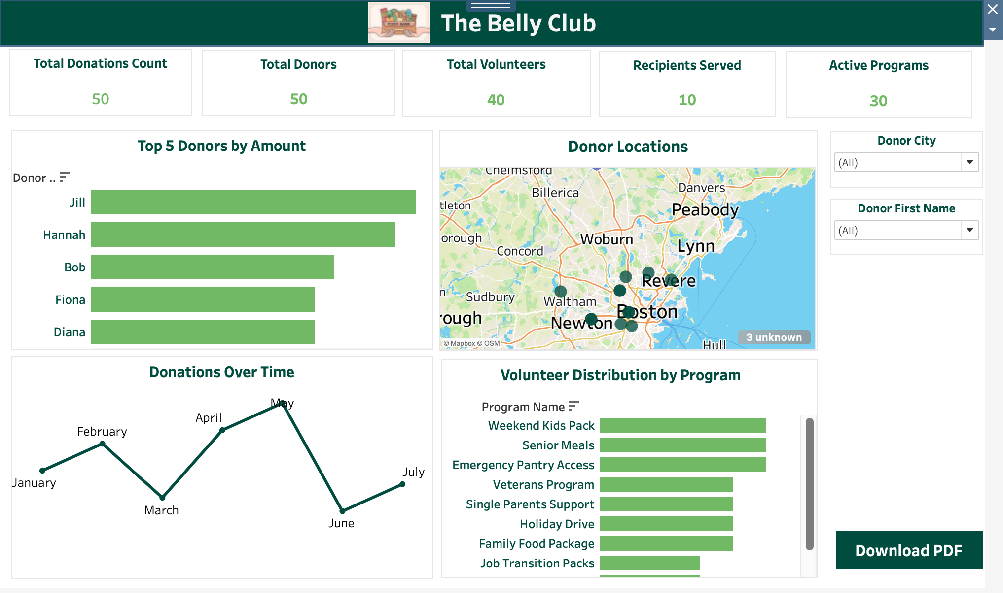
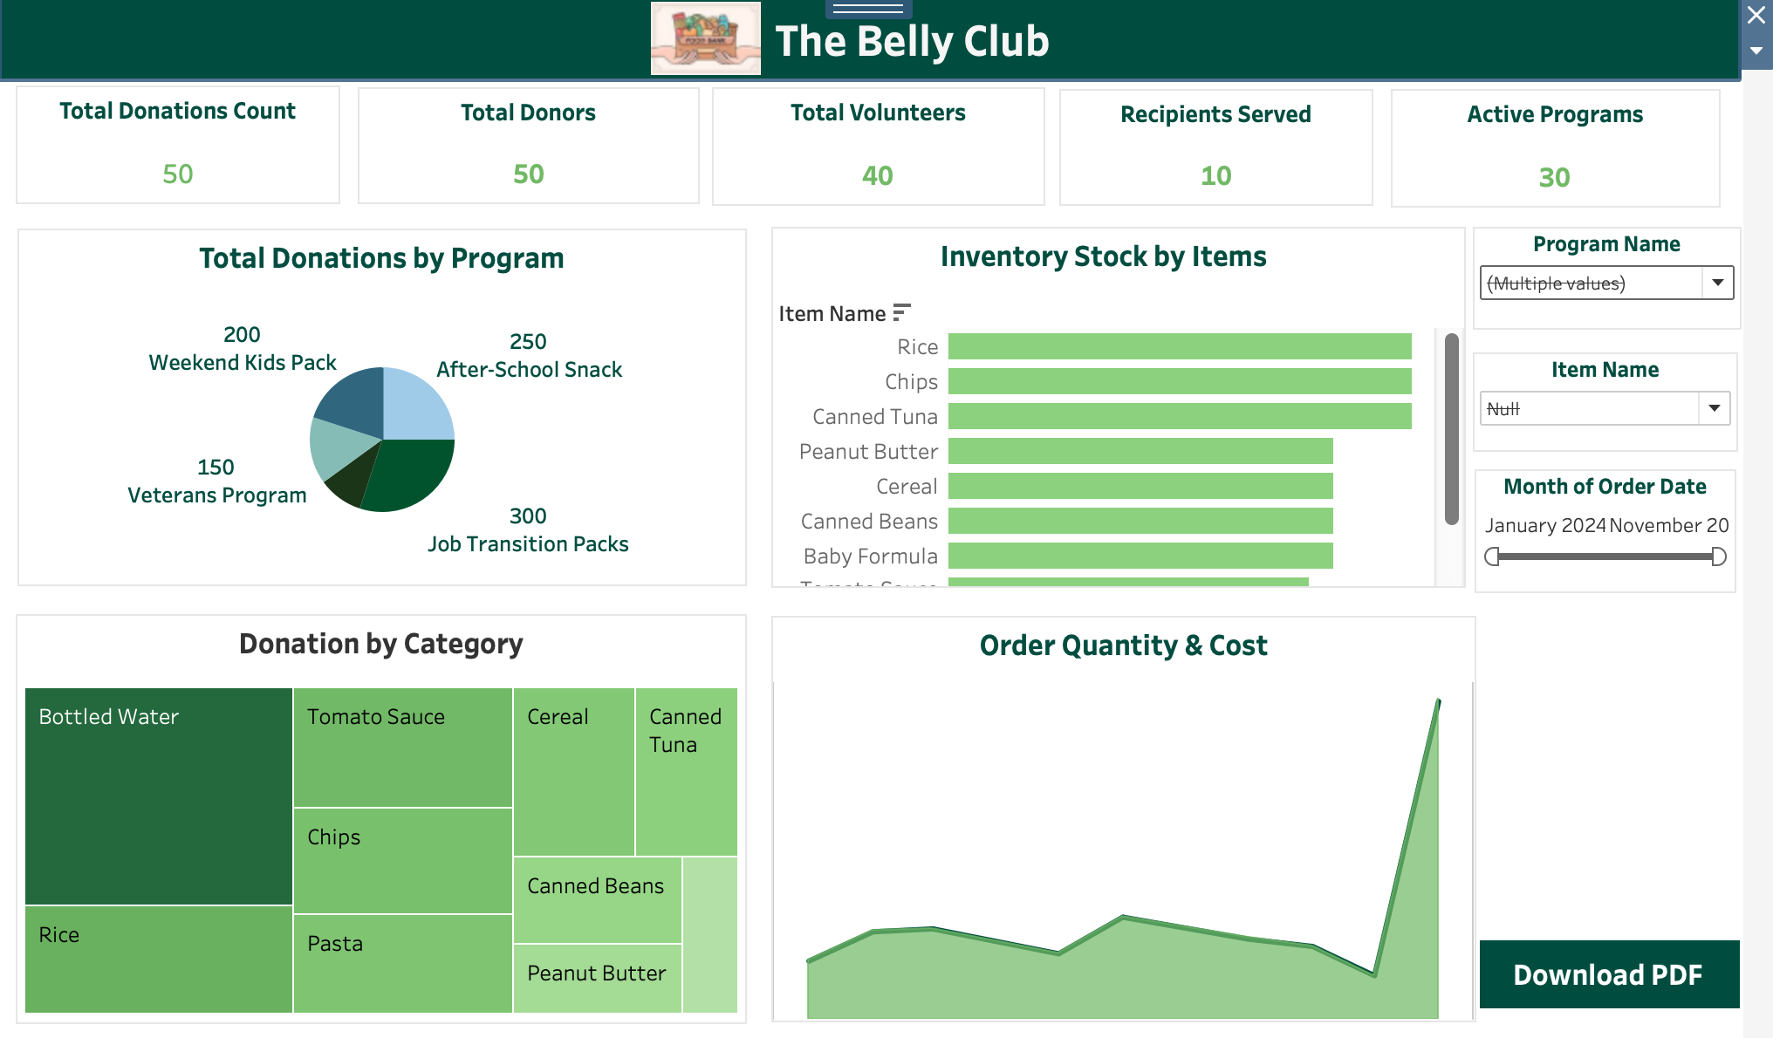
Tableau Report
This dashboard highlights the overall community engagement,
including total donations, donor count, volunteer participation, and
recipients served.
It showcases the top 5 donors, their geographic
distribution, and donation trends over time.
This dashboard focuses on program-specific donation performance and inventory management.
It visualizes total donations by program, donation categories, and current stock levels of key items like rice and canned tuna.

Slide 8
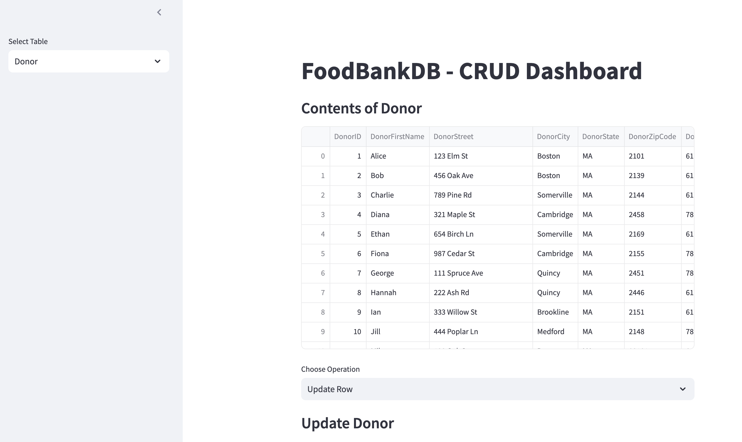
GUI for Schedule and Transactions

Slide 9
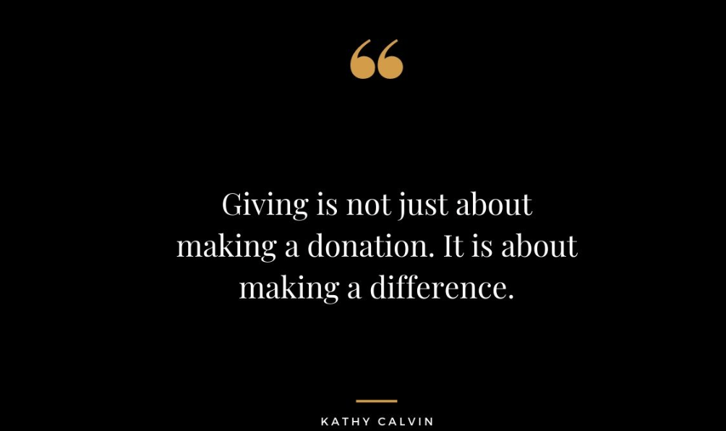

Thank You

